Slide 1

INT 306
Database Management Systems
Lecture 2
‘ Let’s move toward the better way to store and manage the data’

Slide 2

Components of Database
Hardware
Software
Five major components in database system environment
Hardware: It is the actual
computer system used for keeping and accessing the database. DBMS
Data
Users
hardware consists of secondary
storage devices like hard disks.
Software: It is the actual DBMS.
Procedures
Between the physical database
itself and the users of system is a layer of software, called DBMS.

Slide 3

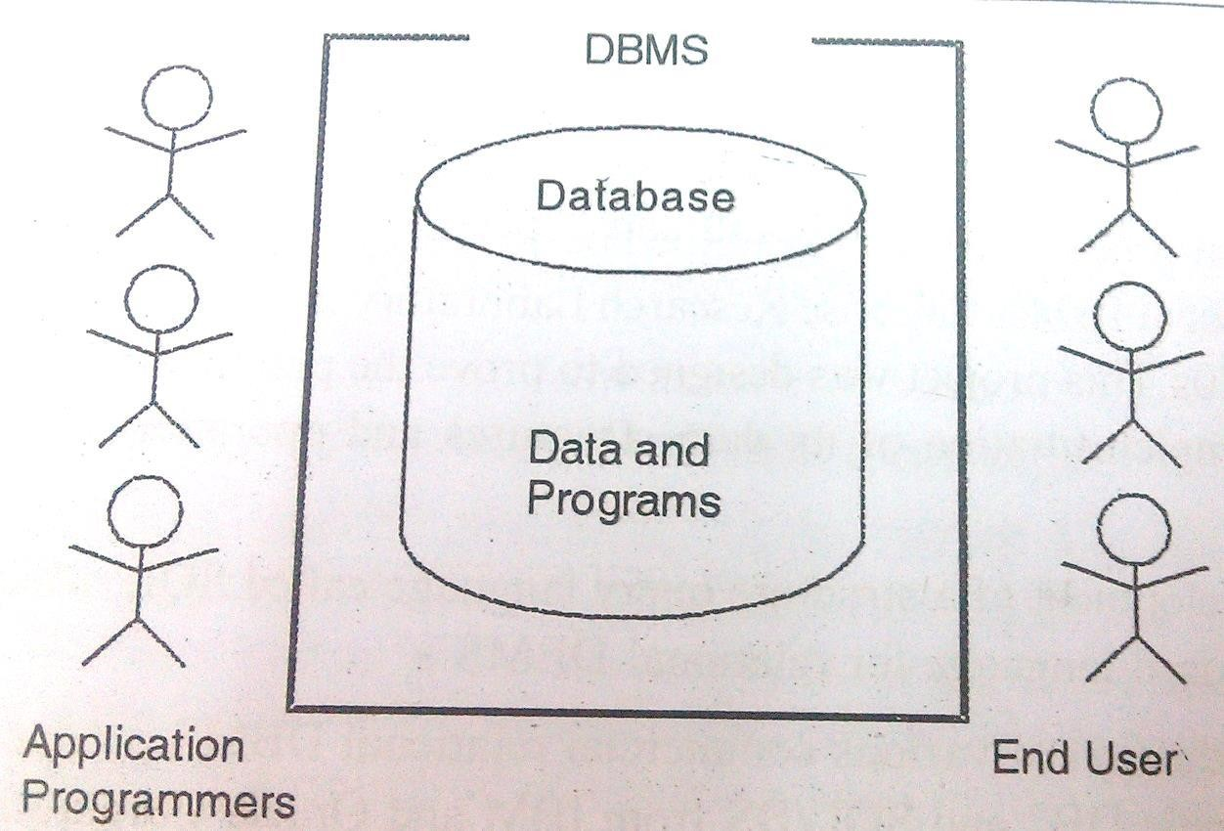
Components of Database
Data: Data acts as the bridge between the machine components and user components.
Users: There are number of users who can access or retrieve data on demand using the applications and the interfaces provided by DBMS.
Procedures: It refers to the instructions and rules that govern the design and the use of the database. The users of the system and the staff that manage the database requires documented procedures on how to use or run the system.

Slide 4

Structure and Components of
DBMS

Slide 5
Storage Management
Storage manager is a program module that provides the interface between the low-level data stored in the database and the application programs and queries submitted to the system.
The storage manager is responsible to the following tasks:
Interaction with the file manager
Efficient storing, retrieving and updating of data
Issues:
Storage access
File organization
Indexing and hashing

Slide 6
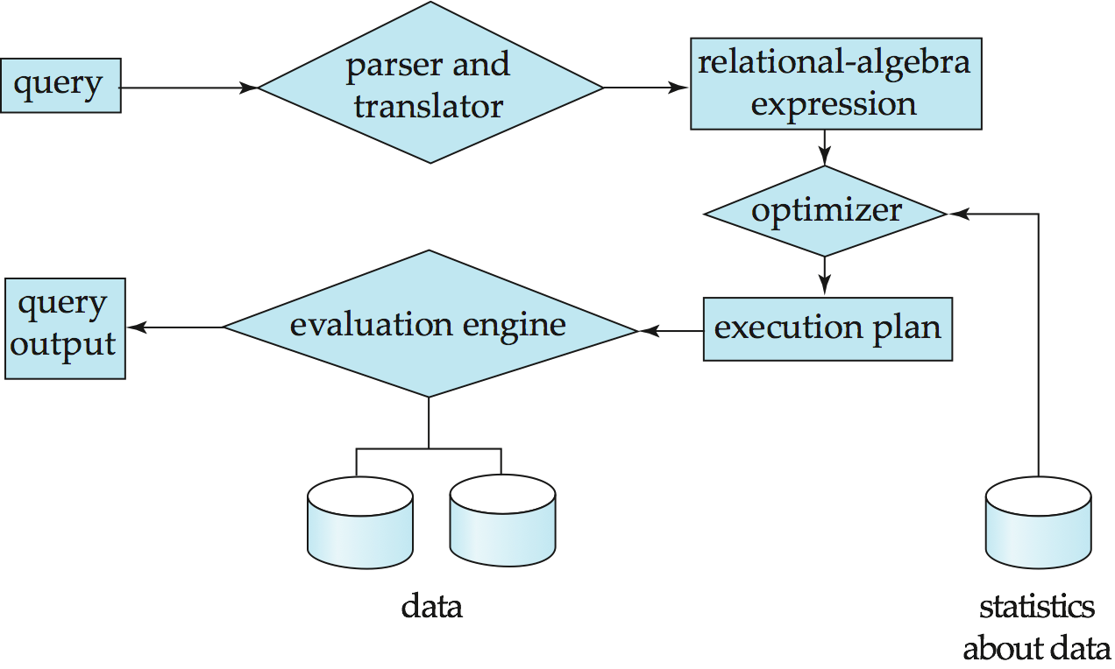
Query Processing
1.
2.
3.
Parsing and translation Optimization Evaluation

Slide 7
Query Processing (Cont.)
Alternative ways of evaluating a given query
Equivalent expressions
Different algorithms for each operation
Cost difference between a good and a bad way of evaluating a query can be enormous
Need to estimate the cost of operations
Depends critically on statistical information about relations which the
database must maintain
Need to estimate statistics for intermediate results to compute cost of complex expressions

Slide 8
Transaction Management
What if the system fails?
What if more than one user is concurrently updating the same data?
A transaction is a collection of operations that performs a single logical function in a database application
Transaction-management component ensures that the database remains in a consistent (correct) state despite system failures (e.g., power failures and operating system crashes) and transaction failures.
Concurrency-control manager controls the interaction among the concurrent transactions, to ensure the consistency of the database.

Slide 10

Database Architecture

Slide 11

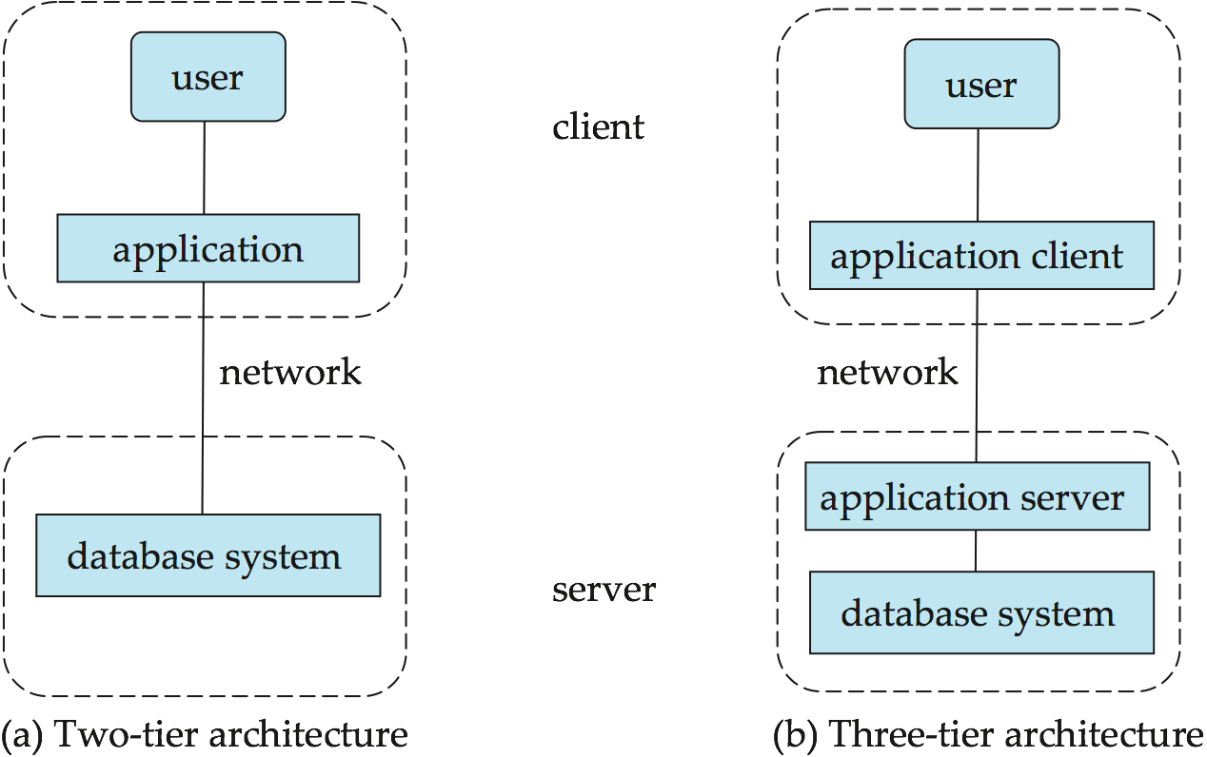
Two tier and Three tier architecture

Slide 12
Data Independence-Achievement of Layered Architecture of DBMS
Two kinds of data independence:
Logical Data Independence: The capacity to change the conceptual schema without having to change the external schemas and their application programs.
Physical Data Independence: The capacity to change the internal schema without having to change the conceptual schema.

Slide 13
Data Independence
The processes of transforming requests and results between the levels are called mappings.
When a schema at a lower level is changed, only the mappings between this schema and higher-level schemas need to be changed in a DBMS that fully supports data independence. The higher-level schemas themselves are unchanged. Hence, the application programs need not be changed since they refer to the external schemas.

